Slide 1
Sociolinguistics: An Introduction
Charalambos Themistocleous
themistocleous@gmail.com

Slide 2
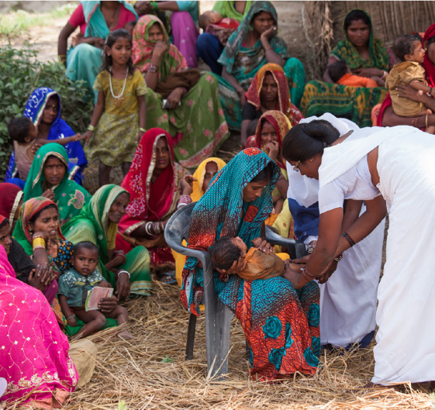
Languages * Cultures * Voices

Slide 3
Linguistics
“Linguistic theory is concerned primarily with an ideal speaker–listener, in a completely homogeneous speech-community, who knows its language perfectly and is unaffected by such grammatically irrelevant conditions as memory limitations, distractions, shifts of attention and interest, and errors (random or characteristic) in applying his knowledge of the language in actual performance.” Noam Chomsky 1965, pp. 3–4

Slide 4

Diversity
People
Languages

Slide 5
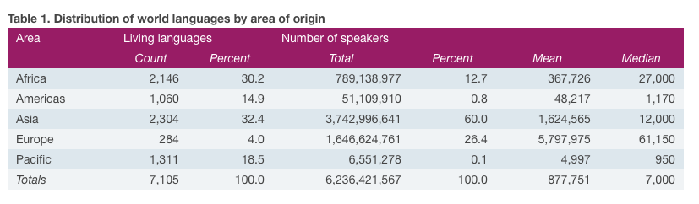
World Population: 6,716,664,407
Living Languages: 7,105

Slide 6
What do you think about this definition?
Variation exists!
Examples of Social Variation!
Examples of Variation within a Speaker!

Slide 7
Sociolinguists’ Reply
“If we look back at the history of linguistics it is rare to find investigations of any language which are entirely cut off from concurrent investigations of the history of that language, or of its regional and/or social distributions, or of its relationship to objects, ideas, events, and actual speakers and listeners in the ‘real’ world. Wardhaugh(1986:9)

Slide 8
Study of Language Variation
Dialectology
Sociolinguistics
First Wave: Labov: Sociophonetics
Second Wave: Milroy: Social Networks, etc.
Third wave: Eckert: Social Meaning, indexing etc.

Slide 9
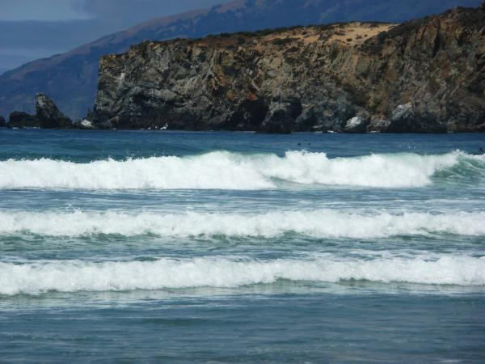
The first wave of variation studies established broad correlations between linguistic variables and the macro-sociological categories of socioeconomic class, sex class, ethnicity and age.
The second wave employed ethnographic methods to explore the local categories and configurations that inhabit, or constitute, these broader categories. In both waves, variation was seen as marking social categories.
The third wave, argues that (1) variation constitutes a robust social semiotic system, expressing the full range of social concerns in a given community; (2) variation does not simply reflect, but constructs, social meaning, hence is a force in social change and (3) the meanings of variables are basic and underspecified, gaining more specific meanings in the context of styles (personae).
Eckert’s Three waves of variation study

Slide 10
Methodological Tools
Depends on the research paradigm:
Questionnaires
Statistics
Ethnographic methods
> Quantitative and Qualitative methods

Slide 11
Questions
Who uses those different forms or language varieties?
Who do they use them with?
Are they aware of their choice?
Why do some forms or languages ‘win out’ over others?
Is there any relationship between the forms in flux in a community of speakers?
What kind of social information do we ascribe to different forms in a language or different language varieties?
How much can we change or control the language we use?

Slide 12
Dialectology

Slide 13
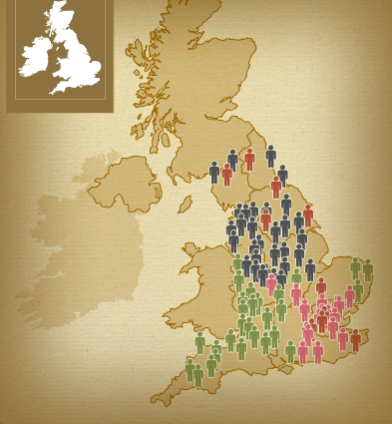
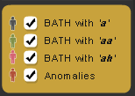
Regional Variation
http://www.bl.uk/learning/langlit/sounds/regional-voices/phonological-variation/

Slide 14
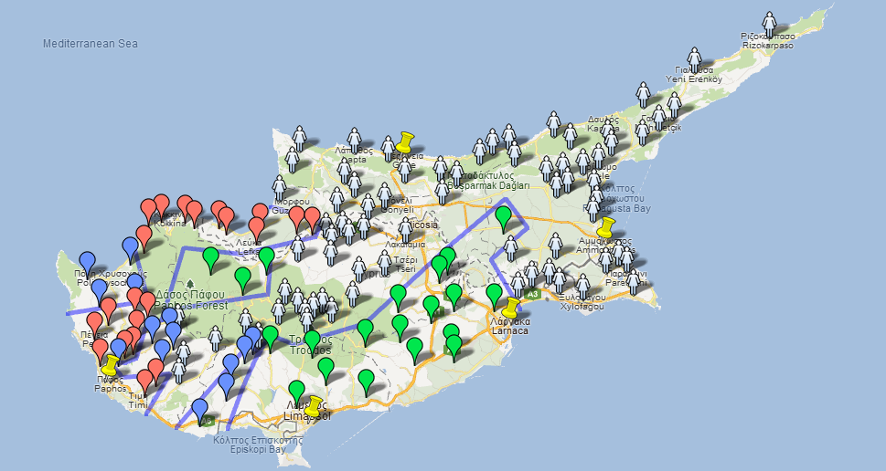
Regional Variation
/epotien/ and /epcaen/ red
/epotixen/ /epcaçen/ blue
/epotisen/ /epcaen/ gray
/epotisen/ /epcasen/ green

Slide 15
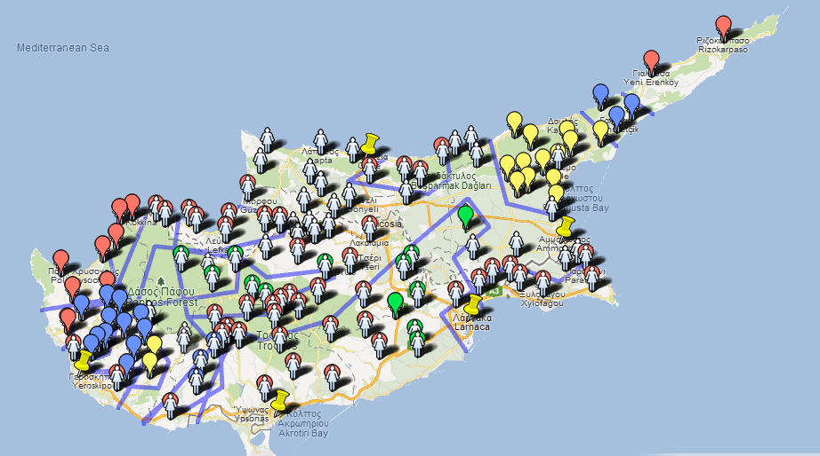
Regional Variation
isoglosses
meat-feaces
/kriˈkas/ /kriˈkoti/
/kopriˈka/ red marker
/kriˈas/ /kriˈkoti/
/kopriˈka/ blue marker
/kriˈas/ /kriˈoti/
/kopriˈka/ yellow marker
/kriˈas/ /kriˈoti/
/kopriˈa/ grey marker

Slide 16
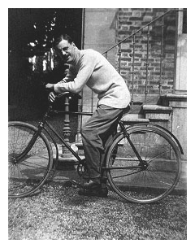
Regional Dialectology
19th Century: Atlas Linguistique de la France (Alf)
The project begun by Jules Gilliéron and the data collection was carried out by Edmond Edmont
Use of a consistent system of
transcription
Standardization of methods.
Edmond Edmont

Slide 17
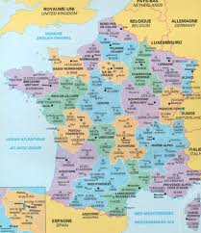
☺ In 2000, three sociolinguists celebrated the 100th anniversary of the completion of Edmont’s fieldwork. David Heap, Naomi Nagy and Jeff Tennant cycled from point 797 to point 798 (the towns of Rivesaltes and Collioure)

Slide 18
Other Atlases
Switzerland, Germany, Italy and Spain: a number of detailed atlas projects were undertaken.

Slide 19
☺ One of the ALPI (Linguistic Atlas of the Iberian Pensinsula) fieldworkers found firsthand how badly people can misundertand linguistic research. Following the military coup in Spain in 1936, Anibal Otero (1911-1974) was arrested while undertaking fieldwork in northen Portugal. He had sent a letter back to his family in Galicia commenting on the legitimacy of the Republican government. On the basis of ‘evidence’ that he was a spy—which included, especially, his suspicious notebooks fill of incomprehensible notes in ‘code’—Otero was convinced for treason and sentenced to death by firing squad.
Scholars testified that his ‘code’ was the phonetic alphabet IPA and this saved his life! He sentence changed to life imprisonment.

Slide 20
How do we create our questionnaire?
What can we ask?
What kind of questions?
Who can ask the questions?
Which can be our subjects?

Slide 21
Difficulties
Dialectologists depend almost entirely on speakers’ reports of what they think they say. This is not always accurate!

Slide 22
Using regional data to inform theory
For some linguists atlases became a tool to inform linguistic theory:
William Moulton used dialect maps of Switzerland and Italy to argue in favour of the principle of Maximum Differentiation.

Slide 23
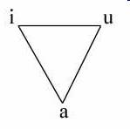
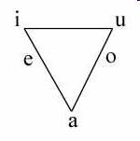
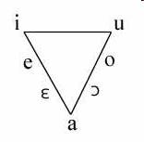
Maximum Differentiation
Three Vowels Five Vowels Seven Vowels

Slide 24
Maximum Differentiation
Moulton noticed that in varieties of Swiss there was a consistent relationship between whether or not a dialect centralised its low, short-a vowel and the number of other low vowels in that variety.
If a variety had a central [a], then it would have both a low front and a low back vowel. But if speakers of one variety had fronted the short-a , then that variety generally did not have another low front vowel.
If speakers had backed the short-a in any particular variety, then that variety generally did not have another low back vowel, it would only have mid back vowel.

Slide 25
Maximum Differentiation
Moulton suggested that speakers prefer to maintain a safe level of differentiation between the phonemes in their language, so if there is change in part of the system they will reorganise the rest of the system so as to keep the distinction between different words clear.
This conclusion was drawn base on the data that atlases provided!

Slide 26
Criticisms of traditional dialectology¹
From the 1960s onwards, however, many people began to voice serious criticisms of the way dialectological data were being collected (see Chambers and Trudgill 1998 for a lengthy discussion).
In almost all cases, long questionnaires were used, with survey workers asking usually non-mobile, old, rural men (NORMs) to respond, usually with one-word answers, to questions such as: 'You sweeten tea with…..?' and 'What do you say to a caller at the door if you want him to enter?' The answers to the questions were then transcribed phonetically by the survey worker.
The critics argued,
firstly, that dialectology should not just be interested in the very small proportion of the population who were old, rural and male, but also include the young, women and those living in towns and cities.
Secondly, they argued that one-word answers to questionnaires were too divorced from everyday language to provide a really accurate account of how people used language - critics suggested that dialectology should study continuous and relaxed conversation which not only would provide examples of more everyday language but also highlight variability within the speech of the individual.

Slide 27
References
Labov W. (1963). The social motivation of a sound change. Word 19:273-309.
Labov W. (1966). The social stratification of English in New York City.
Washington DC: Center for Applied Linguistics
Labov W. (1970). The study of language in its social context. Studium Generale 23: 66-84
Wardhaugh R. (1986). An introduction to sociolinguistics. Oxford: Basil Blackwell
Holmes J. (1992) An introduction to sociolinguistics. London: Longman
http://www.hamline.edu/personal/aschramm/linguistics2001/4casestd.html
http://coral.lili.uni-bielefeld.de/~ttrippel/labov/node4.html

